Slide 1


Team 12

Slide 2




Venkata Chanakya Samsani
Business Analyst
Suryateja Reddy
ML Engineer
Team
Members
Pavan Kalyan Nandamuri
DevOps Engineer
Chandragiri
Giri
Data Engineer

Slide 3
Team
Members
Venkata Chanakya Samsani
Business Analyst
Suryateja Reddy
ML Engineer
Pavan Kalyan Nandamuri
DevOps Engineer
Chandragiri
Giri
Data Engineer

Slide 4
Objective :
The client wants to understand what factors contributed most to employee turnover and to create a model that can predict if a certain employee will leave the company or not. The goal is to create or improve different retention strategies on targeted employees. Overall, the implementation of this model will allow management to create better decision-making actions.
Business Question 3
What key performance indicators (KPIs) will be used to assess the success of the retention strategies, and how will these KPIs be tracked and reported?
Business Question 2
Which departments or teams experience the highest turnover rates, and are there specific factors driving turnover in these areas?
Business Question 1
What are the primary factors contributing to employee turnover within our organization?

Slide 5
Objective :
The client wants to understand what factors contributed most to employee turnover and to create a model that can predict if a certain employee will leave the company or not. The goal is to create or improve different retention strategies on targeted employees. Overall, the implementation of this model will allow management to create better decision-making actions.
Business Question 2
Which departments or teams experience the highest turnover rates, and are there specific factors driving turnover in these areas?
Business Question 3
What key performance indicators (KPIs) will be used to assess the success of the retention strategies, and how will these KPIs be tracked and reported?
Business Question 1
What are the primary factors contributing to employee turnover within our organization?

Slide 6
Objective :
The client wants to understand what factors contributed most to employee turnover and to create a model that can predict if a certain employee will leave the company or not. The goal is to create or improve different retention strategies on targeted employees. Overall, the implementation of this model will allow management to create better decision-making actions.
Business Question 3
What key performance indicators (KPIs) will be used to assess the success of the retention strategies, and how will these KPIs be tracked and reported?
Business Question 2
Which departments or teams experience the highest turnover rates, and are there specific factors driving turnover in these areas?
Business Question 1
What are the primary factors contributing to employee turnover within our organization?

Slide 7
Objective :
The client wants to understand what factors contributed most to employee turnover and to create a model that can predict if a certain employee will leave the company or not. The goal is to create or improve different retention strategies on targeted employees. Overall, the implementation of this model will allow management to create better decision-making actions.
Business Question 3
What key performance indicators (KPIs) will be used to assess the success of the retention strategies, and how will these KPIs be tracked and reported?
Business Question 2
Which departments or teams experience the highest turnover rates, and are there specific factors driving turnover in these areas?
Business Question 1
What are the primary factors contributing to employee turnover within our organization?

Slide 8
Phases of Data Processing
Phases of Data Processing
Phases of Data Processing
Phases of Data Processing
Phases of Data Processing

Slide 9
Phases of Data Processing
Phases of Data Processing
Phases of Data Processing
Phases of Data Processing
Phases of Data Processing

Slide 10

CRISP - DM
Data Preparation
Data Modeling
Evaluation
Deployment
Business Understanding
Data Understanding

Slide 11
CRISP - DM
Data Understanding
Data Preparation
Business Understanding
Data Modeling
Deployment
Evaluation

Slide 12
Data Modeling
Model Evaluation
Deployment
Exploratory
Data
Analysis
Refining Data
Gathering Data
Proposed Solution

Slide 13

Proposed Solution
Data Modeling
Model Evaluation
Deployment
Exploratory Data Analysis
Refining Data
Gathering Data

Slide 14









Proposed Solution
Data Modeling
Model Evaluation
Deployment
Exploratory Data Analysis
Refining Data
Gathering Data

Slide 15

Proposed Solution
Data Modeling
Model Evaluation
Deployment
Exploratory Data Analysis
Refining Data
Gathering Data

Slide 16

Data
Modeling
Model
Evaluation
Deployment
Exploratory
Data
Analysis
Refining
Data
Gathering
Data
Proposed Solution
The information was sourced from Kaggle's "Human Resources Analytics" dataset, which is a simulated representation of a fictitious company. This dataset includes 14,999 employee records with fabricated features and observations, designed to resemble a real-world scenario.

Slide 17
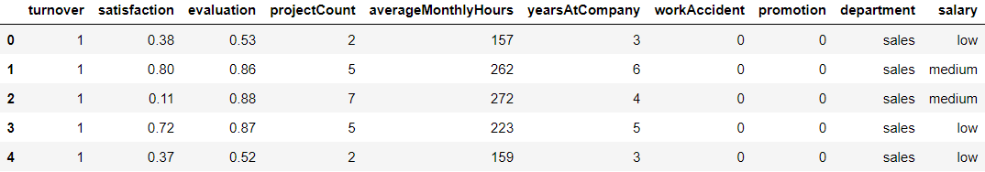
Data
Modeling
Model
Evaluation
Deployment
Exploratory
Data
Analysis
Gathering
Data
Proposed Solution
Our task is to review the dataset to ensure its readability and that observation values are appropriately aligned with feature names. This process includes:
Categorizing data like the "department" and "salary" features.
Enhancing feature names for improved clarity.
Feature selection with a decision tree classifier.
Verifying the presence of any missing values within the dataset.
Refining Data

Slide 18
Data
Modeling
Model
Evaluation
Deployment
Exploratory
Data
Analysis
Gathering
Data
Proposed Solution
Refining Data
Our task is to review the dataset to ensure its readability and that observation values are appropriately aligned with feature names. This process includes:
Categorizing data like the "department" and "salary" features.
Enhancing feature names for improved clarity.
Feature selection with a decision tree classifier.
Verifying the presence of any missing values within the dataset.

Slide 19
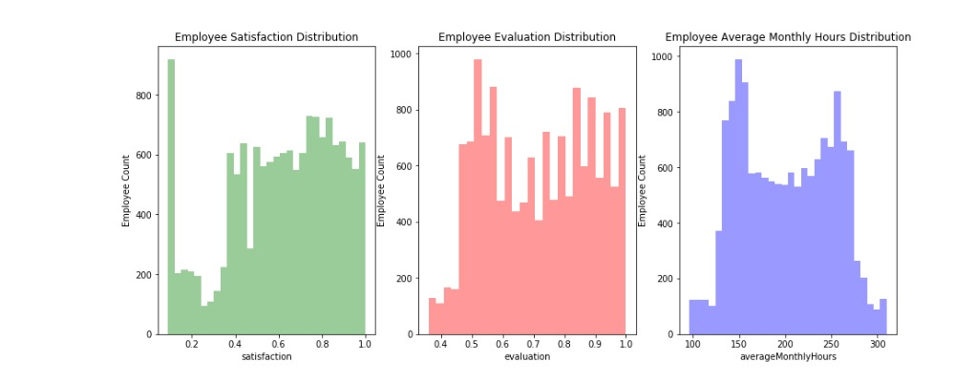
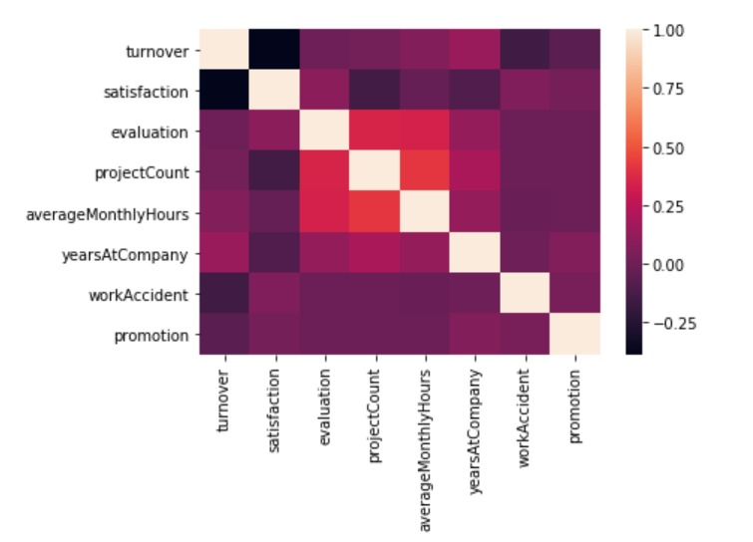
Data
Modeling
Model
Evaluation
Deployment
Exploratory
Data
Analysis
Refining
Data
Gathering
Data
Proposed Solution
The correlation between the variables: projectCount, averageMonthlyHours, and evaluation.
What features affect our target variable (turnover) the most?
A more direct cause for employee turnover in each department.
Employees who left generally were underworked or overworked?

Slide 20
Data
Modeling
Model
Evaluation
Deployment
Exploratory Data Analysis
Refining
Data
Gathering
Data
Proposed Solution

Slide 21
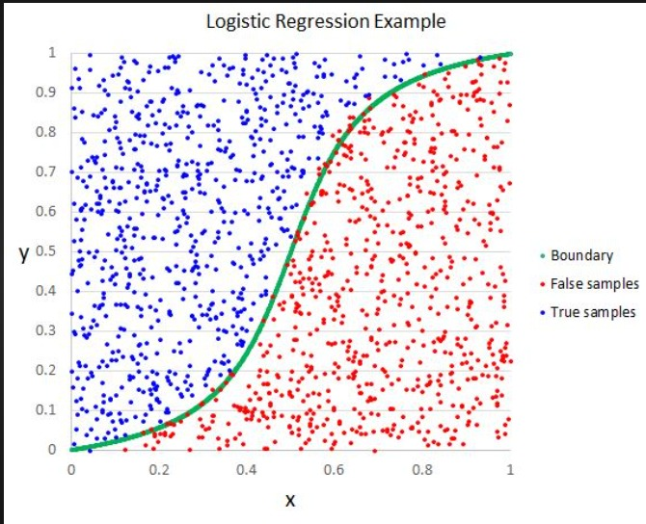
Data
Modeling
Model
Evaluation
Deployment
Exploratory
Data
Analysis
Refining
Data
Gathering
Data
Proposed Solution
Our goal is to build a logistic regression model to make predictive insights on the probability of an employee turnover, and to make a model that can be applied throughout the various departments of the company and can be used as an aid to help make better decisions in employee retention.

Slide 22
Data Modeling
Model
Evaluation
Deployment
Exploratory
Data
Analysis
Refining
Data
Gathering
Data
Proposed Solution

Slide 23
Data
Modeling
Model
Evaluation
Deployment
Exploratory
Data
Analysis
Refining
Data
Gathering
Data
Proposed Solution
Key Considerations:
Data Quality: Check for missing values, outliers, and inconsistencies.
Metrics: Select appropriate evaluation metrics (accuracy, precision, etc.).
Cross-Validation: Assess stability and generalization.
Overfitting/Underfitting: Avoid under/over-complex models.
Hyperparameter Tuning: Optimize model settings.
Business Impact: Align model with real-world objectives.
Interpretability: Explain model predictions.
Assess model performance and effectiveness.
Ensure the model generalizes well to unseen data.
Continuous process, iteratively improving model quality.

Slide 24

Data
Modeling
Model
Evaluation
Deployment
Exploratory
Data
Analysis
Refining
Data
Gathering
Data
Proposed Solution
Azure Machine Learning: Utilize Azure ML services.
Containerization: Create Docker containers for models.
Scalability: Scale resources as needed.
Monitoring: Continuously track model performance.
Versioning: Maintain model version control.

Slide 25
Data
Modeling
Model
Evaluation
Deployment
Exploratory
Data
Analysis
Refining
Data
Gathering
Data
Proposed Solution
Thank you
For
your time!

